Slide 1

Project Title - Seasonal Agriculture Performance Analysis
Student Name- Samyak Biswas
College Name- University of Engineering and Management, Kolkata
AICTE STU ID : STU68cc048fb52df1758200975

Slide 2

PROBLEM STATEMENT
Agricultural performance varies across different seasons due to changes in environmental conditions, farming practices, resource availability and market conditions.
The raw agricultural dataset does not clearly show how yield, profitability, resource usage and other performance indicators change across seasons.
Therefore, this project focuses on analyzing agricultural data to identify seasonal patterns, trends, relationships and differences in agricultural performance.

Slide 3
Project Description This project analyses farm-level agricultural data across Kharif, Rabi and Zaid seasons. The analysis includes data cleaning, exploratory data analysis, statistical analysis and visualization to understand differences in: • Crop yield • Profitability • Water usage and efficiency • Irrigation methods • Environmental conditions • Disease and pest risk • Crop and regional performance The final objective is to generate meaningful insights and data-driven recommendations for better seasonal agricultural planning.

Slide 4

WHO ARE THE END USERS?
1. Farmers & Farm Managers To understand seasonal crop performance and resource usage.
2. Agricultural Planners To support evidence-based seasonal planning.
3. Irrigation & Resource Managers To understand water usage and efficiency.
4. Agricultural Businesses To evaluate crop performance and profitability.
5. Researchers & Data Analysts To study agricultural patterns and develop improved analytical models.

Slide 5

Technology Used
Programming Language: Python
Development Environment: Jupyter Notebook
Libraries:
• Pandas – Data cleaning and analysis • NumPy – Numerical calculations • Matplotlib – Data visualization • SciPy – Statistical analysis
Dataset: CSV-based agricultural dataset
Techniques: Data Cleaning, Exploratory Data Analysis, Correlation Analysis, Statistical Testing and Data Visualization

Slide 6
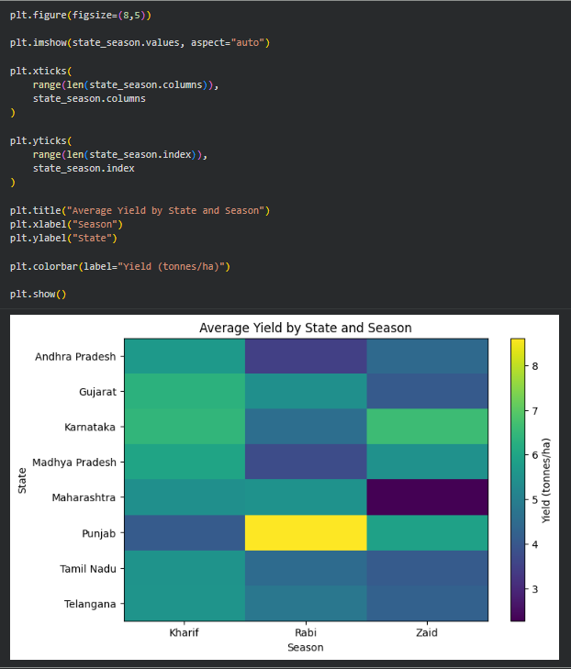
RESULTS
This heatmap shows the average yield across different states and seasons. The rows represent states and the columns represent Kharif, Rabi and Zaid seasons. The colour indicates the average yield, where yellow represents higher values and darker colours represent lower values. We can see that Punjab has the highest average yield in Rabi, at around 8.61 tonnes per hectare. Karnataka also performs very well during Zaid, at around 6.63 tonnes per hectare. On the other hand, Maharashtra has a relatively low Zaid yield of around 2.28 tonnes per hectare. Overall, this shows that seasonal agricultural performance varies from state to state, so agricultural planning should consider regional conditions.

Slide 7
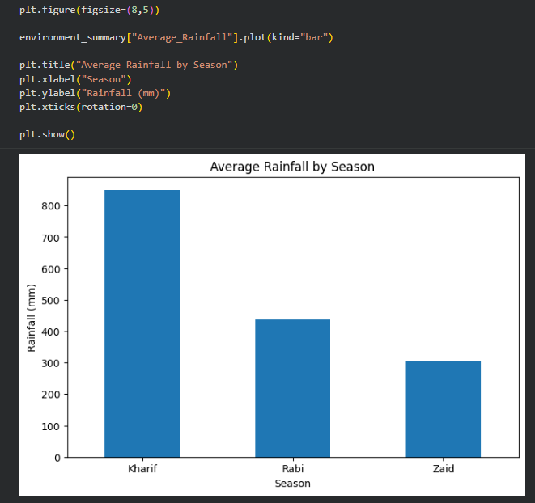
RESULTS
This graph represents the average rainfall for each season. We can see that Kharif receives the highest average rainfall, approximately 849 millimeters. Rabi receives around 438 millimeters, while Zaid receives around 305 millimeters. Therefore, there is a clear decrease in rainfall from Kharif to Zaid. This environmental difference provides useful context when comparing agricultural performance across the three seasons.

Slide 8
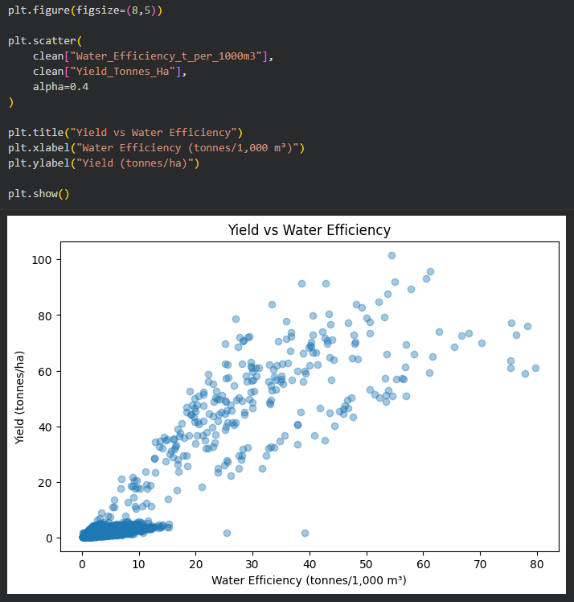
RESULTS
This scatter plot shows the relationship between water efficiency and agricultural yield. The X-axis represents water efficiency in tonnes per 1,000 cubic meters, while the Y-axis represents yield in tonnes per hectare. Each point represents an observation from the dataset. We can see an overall upward pattern, which means that higher water-efficiency values are generally associated with higher yields. Our correlation analysis gives a value of approximately 0.91, indicating a strong positive relationship. However, this is a correlation and does not mean that water efficiency alone causes higher yield, because other agricultural factors can also influence production.

Slide 9
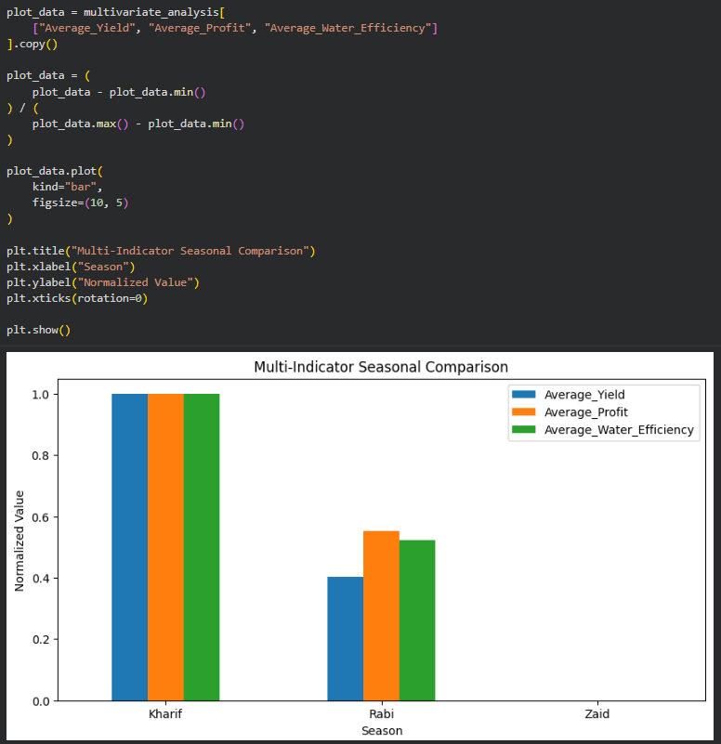
RESULTS
This is my multivariate analysis, where I am comparing three different performance indicators together: average yield, average profit and average water efficiency. Since these variables have different units and scales, I normalized their values between zero and one. Kharif reaches the highest normalized value across all three indicators, while Rabi has intermediate values. Zaid has a normalized value of zero because it has the lowest value among the three seasons for these indicators. This graph therefore shows that Kharif has the strongest overall performance across these selected indicators.The zero value for Zaid does not mean that there is no data for Zaid. It means that Zaid is the minimum reference value after normalization.

Slide 10
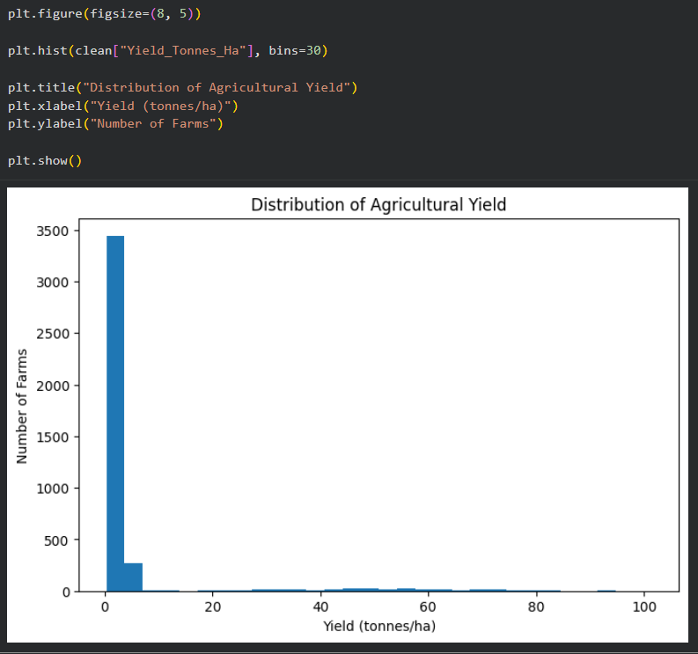
RESULTS
This histogram represents the distribution of agricultural yield across the farms. The majority of observations are concentrated at relatively lower yield values, while a smaller number of observations have much higher yields. This creates a strong right-skewed distribution with a long tail toward higher values. One possible reason is that the dataset contains different types of crops, which naturally have very different yield ranges. Therefore, these high values should be investigated rather than automatically treated as errors.

Slide 11
Future scope • Use multi-year agricultural data for more reliable seasonal analysis. • Integrate historical and forecasted weather data. • Develop crop- and region-specific recommendation systems. • Build machine-learning models for yield and profit prediction. • Include market-price forecasting. • Develop an interactive agricultural dashboard. • Monitor irrigation, fertilizer and pesticide efficiency over time.

Slide 12
GitHub Link
https://github.com/samyakbiswas729-dev/Seasonal-Agriculture-Performance-Analysis

Slide 13

VOIS Course completion certificate - Course name- Data Visualization

Slide 14
Thank you
.
.

